Slide 1
Relevance Displays: A case study in RecSys UI Research
Guy Shani
Information Systems Engineering
Ben Gurion University
Israel
Collaborators: Lior Rokach, Bracha Shapira, Noam Tractinski, Moran Tangi, Sarit Hadash, Baruch Kozirovski, Yan Yosilevich

Slide 2
Before Starting with Relevance Displays
Let’s talk a bit about research in recommendation UI
Or lack there of….

Slide 3
User Experience in Recommender Systems
“The delivery of the recommendations to the user and the interaction of the user with those recommendations” [Konstan and Riedel, 2010]
“Users’ subjective evaluation of their interaction with the system” [Knijnenburg et al. 2011]

Slide 4
User Interfaces in Recommendation Systems
UX (user experience) involves the entire interaction process
UI (user interface) focuses on the interface of the system
The display of recommendations
The available immediate actions
“Inspectability and Control elements” – John O’Donvan, RecSys, 2012
“User interface matters” – Joe Konstan, RecSys tutorial, 2010

Slide 5
User Interfaces for Recommender Systems
Recommender system user interfaces are like the weather
Everybody talks about it
“Users see the entire application, not just the recommender algorithm” [Konstan, 2010]
“a usable interface will increase the user’s subjective evaluation of the system” [Ricci et al. RecSys Handbook intro, 2011]
“the perceived value of the recommender depends on the user interface” [Jannach et al., 2010]
“The user interface of a recommender system can have a critical and decisive effect” [UMUAI CFP for special issue on UI, 2010]
“To ensure that TV recommender systems become successful, much attention should be paid to the user interface” [Van Barneveld and Van Setten, 2004]

Slide 6
User Interfaces for Recommender Systems
Recommender system user interfaces are like the weather
But nobody does anything about it
Excluding certain research areas – will discuss in a minute

Slide 7
User Interfaces for Recommender Systems
Recommender system user interfaces are like the weather
But nobody does anything about it
UI Workshop in RecSys 2012:
Half day
3 papers
UMUAI special issue:
Only 4 papers
Recommender Systems, An Introduction [Jannach et al. 2010]
No chapter on user interfaces
RecSys handbook [Ricci, Shapira, Rokach, 2011]
Some chapters mention UI, but only as a side issue

Slide 8
User Interfaces for Recommender Systems
Well, not quite true…
Several UI issues have been studied extensively
Preference elicitation, most notably, Pearl Pu and her team
Conversational recommenders (critiquing), Pu, Ricci, …
Explanations – many people
But – these 3 areas are highly algorithmic oriented
Which items should I ask the user about?
Example based preference elicitation
Which attributes should be shown to the user to critique?
How should we transform the algorithm output into a human readable explanation?
Focus is on what to show, not on how to show it

Slide 9
User Interfaces for Recommender Systems
Why are only some questions investigated?
Some people focus on the user experience (UX)
User centric evaluation of recommender systems [Knijnenburg et al. 2012]
“Algorithms embedded in the context of the application” [Konstan and Riedel, 2012]
Maybe we like algorithms, so we put our focus where the algorithm is.
But many UI questions are not naturally algorithmic

Slide 10
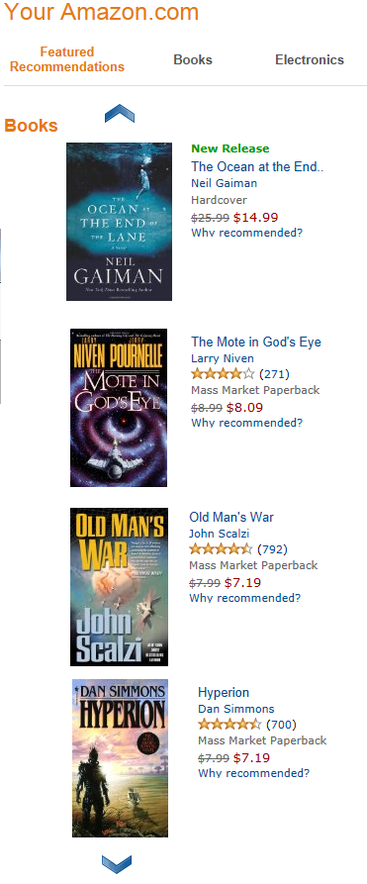
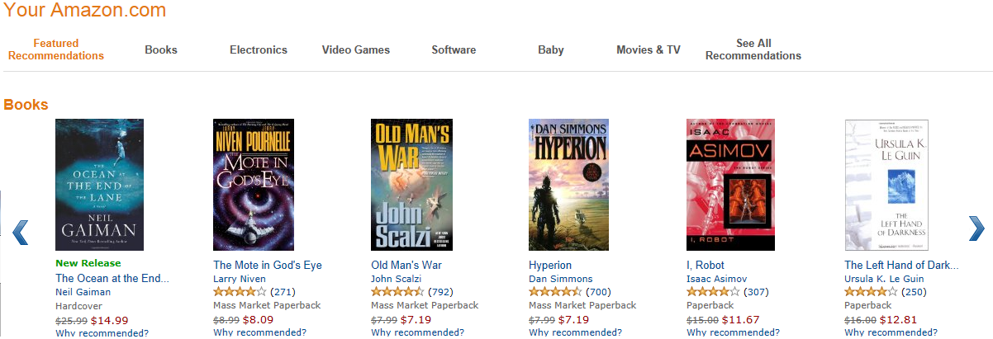
User Interfaces Questions
Vertical vs. Horizontal
How do users respond to recommendation list orientation?

Slide 11
User Interfaces Questions
Scrolling
Do users scroll?
Should we scroll one item or all “page”?

Slide 12
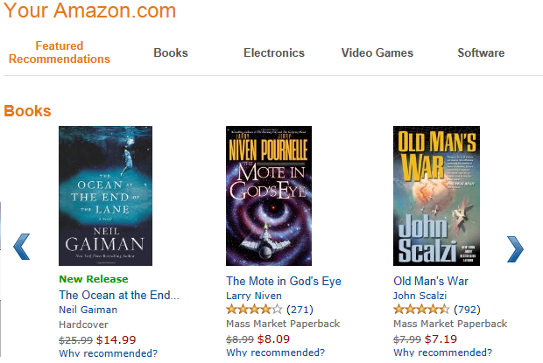
User Interfaces Questions
How many items should we display?
1, 3, 5, 10?

Slide 13
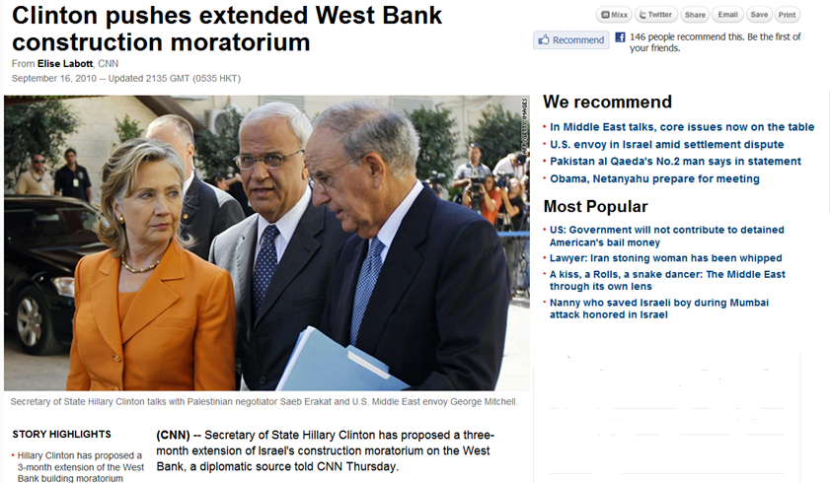
User Interfaces Questions
What is the difference between textual recommendations and images?

Slide 14
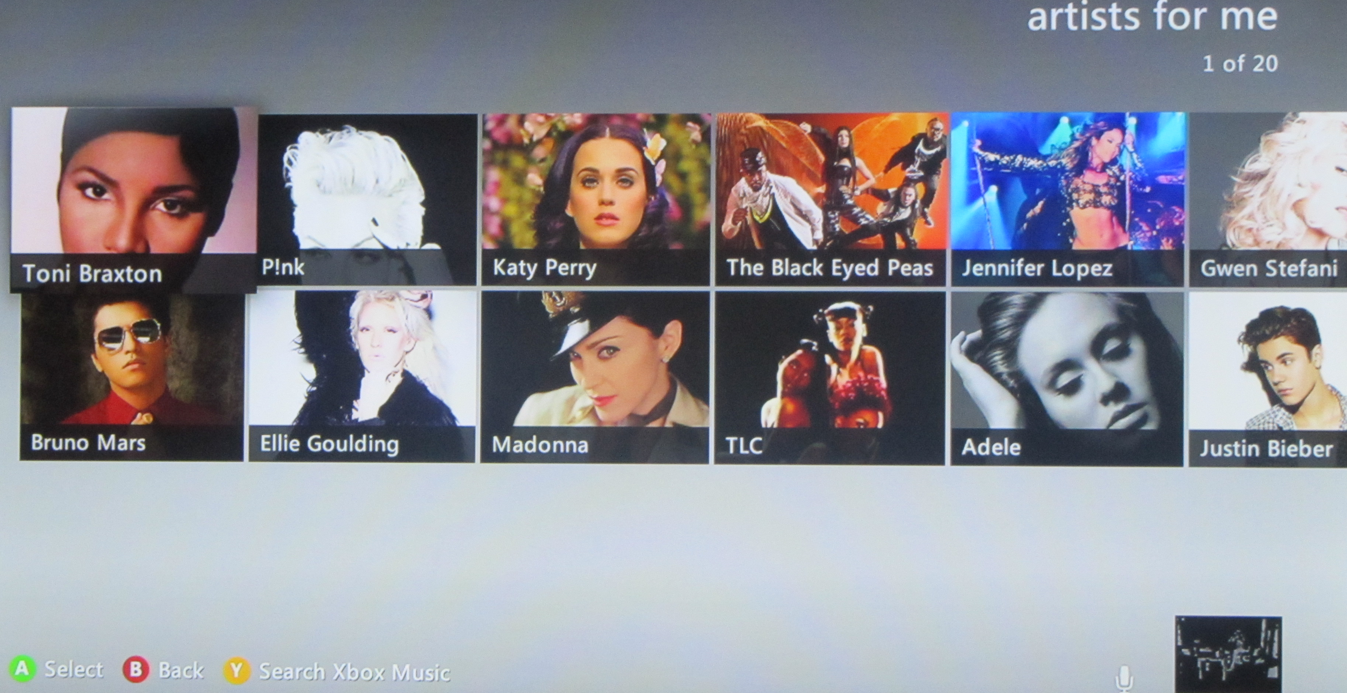
User Interfaces Questions
Should we display information about the recommended items, or just images?

Slide 15
User Studies
Typical UI question: “how does the display of X affects user behavior?”
Answer requires experimenting with real users
User studies are harder than offline simulations
Guidelines:
Within vs. Between subjects
Controlled environment vs. flights
Hiding the hypothesis
Questionnaires
Pilot studies

Slide 16
User Studies
Typical UI question: “how does the display of X affects user behavior?”
Answer requires experimenting with real users
User studies are harder than offline simulations
Need to recruit people (volunteers, paid subjects, raffle)
Create an application (demo)
Create a good questionnaire (pilot studies help)
Get everything right, because fixing your mistakes is VERY costly

Slide 17
Case Study: Relevance Displays for Recommendations

Slide 18
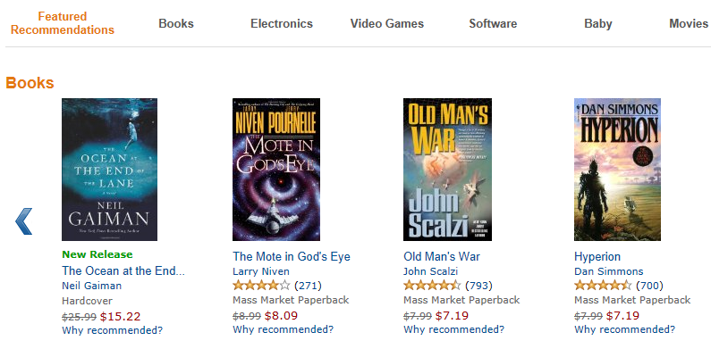
Recommended Item Relevance
These are the books that Amazon recommended for me
Are they all equally likely to be interesting or relevant?
Perhaps the leftmost item is the most interesting
How interesting is the second item?

Slide 19
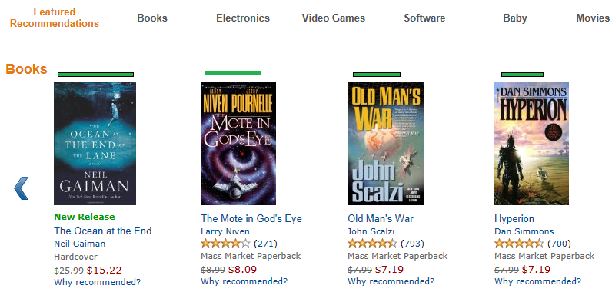
Relevance Display
Suggestion: show alongside a recommendation a graphical display of the relevance of that item to the user
Possible benefits:
“when should I stop scrolling?”
Explain system behavior
Increase trust

Slide 20
Confidence
From statistics
Given an estimation or predictions
Compute the confidence in the estimation
Example: estimating a mean
With each sample the estimation of the mean changes
With each sample the confidence in the current estimation grows
In hypothesis testing we are required to report our confidence (p-value)

Slide 21
Confidence in Recommendation Systems
Different type of confidence:
Probability of the item being relevant to the user (top-N recommendations)
Probability of user giving 4 stars to the item (rating prediction)
Confidence interval – the range that contains the true rating with probability above 0.95

Slide 22
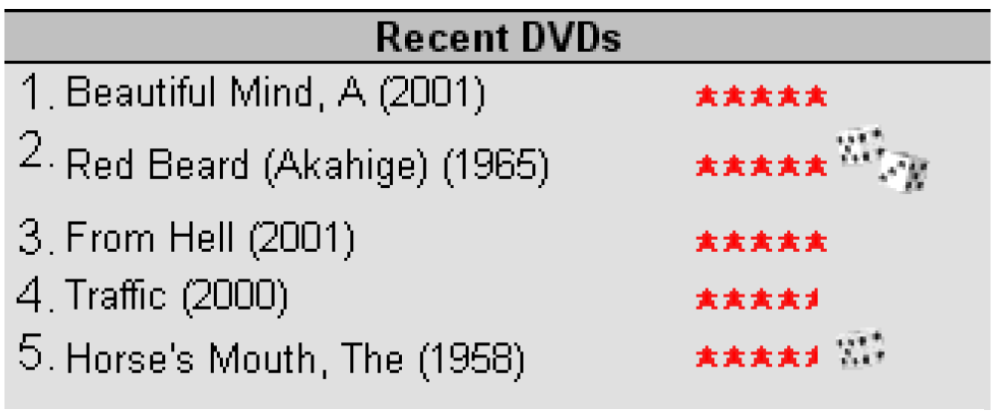
Confidence in Recommender Systems
McNee et al. (2003) suggest marking “risky” predictions
In CF, confidence in the prediction is correlated with the number of neighbors who rated an item
User study conclusions:
Users notice the displays
Experienced users click more on “risky” items – looking for serendipity?
Risk-averse users do not click on “risky” items

Slide 23
Confidence in Recommender Systems
In rating prediction the system can compute two different values:
Predicted rating
Confidence in the prediction
In Top-N recommendations items are sorted by relevance / confidence
There is only a single value

Slide 24
Various Confidence Displays
We define a set of confidence displays, using the following guidelines
Match between the system and the real world
Try to use well known graphical displays
Use displays which provide metaphors for confidence / relevance
Minimalist design
Evaluate a range of expressiveness
Consistency with standards
Red = bad
Green = good

Slide 25
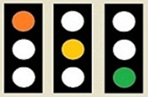
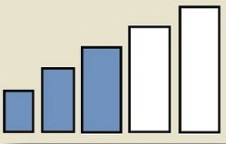
Discrete Displays
A set of displays with discrete values
A range of possible values
Various metaphors
2 levels, simplest
3 levels, “risk”
4 levels, “luck”
6 levels, well known display
13 levels, high expressive power

Slide 26
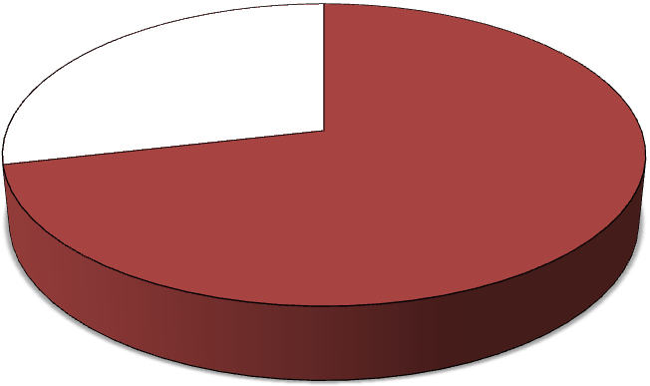
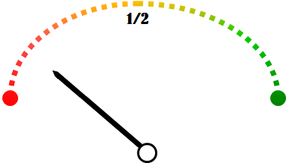
Continuous Displays
Graphical displays that can present continuous values
Commonly used in business analytics
Well known display. Red/green relate to risk.

Slide 27
Interval Displays
Allow representing confidence intervals
Often used to represent confidence intervals in graphs
Stars are typically associated with ratings and recommendations

Slide 28
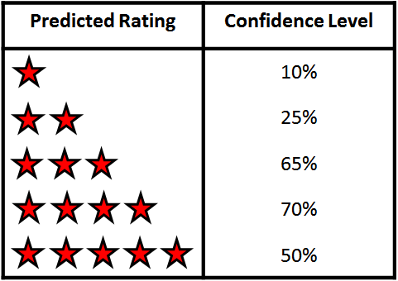
Rich Displays
Can represent all available information
For each rating, what is the likelihood of that rating
Numeric display
Graphical display, avoid confusing two numeric information types

Slide 29
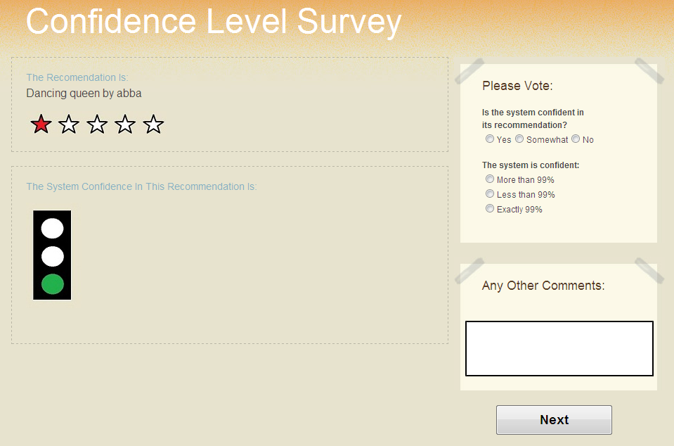
User Study for Evaluating the Displays
29 students, within subjects
Goals
Do users understand the displays?
Is training required?
Users were shown queries
Each query contained a recommendation
Given a song, recommend another song
A confidence display was shown alongside the recommended song

Slide 30
User Study for Evaluating the Displays
The system
Randomly picks a confidence
Constructs an appropriate display
Create a relevant question
Questions:
“Is the system confident in its recommendations?”
Yes, Somewhat, No
“How confident is the system?”
“Less than 60%”
“Between 60% and 80%”
“More than 80%”

Slide 31
User Study for Evaluating the Displays
Answer accuracy (#correct answers / #queries)
Up-Down arrow and Fuel Gauge seem best
Star interval is worst (confused with rating?)

Slide 32
User Study for Evaluating the Displays
Answer accuracy (#correct answers / #queries)
Surprise: Confidence Table does fairly well

Slide 33
User Study for Evaluating the Displays
Training:
After evaluating all displays
Users were shown a short explanation for each display
After training we showed a second round of queries
SR = success rate
Before/After training
Q1 = Confident yes/no
Q2 = How confident?

Slide 34
User Study for Evaluating the Displays
Statistically significant improvement for 3 displays (require explanations)

Slide 35
Confidence Display Effect on Users
Second user study
Questions:
Do users behave differently when confidence displays are presented?
Can confidence displays help users choose relevant items?
Evaluate displays within a recommendation system
3 displays were chosen:
Various types (discrete, continuous, rich)
Relatively accurate
Sufficiently rich

Slide 36
User Study Interface
Hiding research focus:
declared goal “which recommendation system is better”
2 Domains
Movies: item-item
Image tags
No explanation unless requested

Slide 37
Recommended Item Relevance
Movies:
Relevant movies – high Jaccard score, MovieLens dataset
Less relevant movies – random popular movies that share one genre with the query movie
Tags:
No recommendation algorithm
Using the NUS-WIDE dataset
Relevant tag list – tags that were used for that image in the dataset
Not relevant list – image tags are replaced with frequently co-occurring tags
Partially relevant list – combination of the above (only some tags are replaced)
Relevance scores are randomly chosen based on relevance group

Slide 38
User Study Population
Within subjects
Each subject evaluates both domains
With / without relevance display
3 relevance display types
Query order is randomized
160 participants
15 mandatory questions for each participant (to enter a raffle)
21 participants did not complete the 15 questions
Total of 10,945 queries were observed
6,397 image tags
4,548 movie recommendations

Slide 39
Recommendation Relevance Identification Accuracy
Can users identify which alternative is relevant and which is not?
Tags relevance is easier to identify
In movies, non-relevant are easier to identify
In both cases, relevance displays do not help to identify relevance

Slide 40
Evaluating Cognitive Effort (Time to Respond)
Tags – less time needed without relevance display
Especially for correctly identifying relevant tags (easiest task?)
Lesser effect in the movies domain

Slide 41
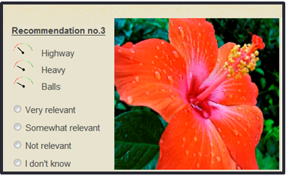
What Happens When Users “Don’t Know”?
Less “don’t know” for relevant items using bars + fuel
More “don’t know” when the stars display is used
Confusing display?

Slide 42
Do Users Believe the Relevance Display?
Displaying high relevance for non-relevant items
Test whether users trust the displayed relevance
10% of the queries
Splitting to two groups:
Group 1 - relevance displayed from the start
Group 2 - no relevance displays initially

Slide 43
Did Participants Understand the Displays

Slide 44
Conclusions from User Studies
Understandability:
Discrete displays are the most understandable
Displays based on well-known graphics are easier to understand
Relevance displays are natural to users
Trust
Users trust the confidence display
Trust is built over time
Relevance scores did not help users to identify relevant items

Slide 45
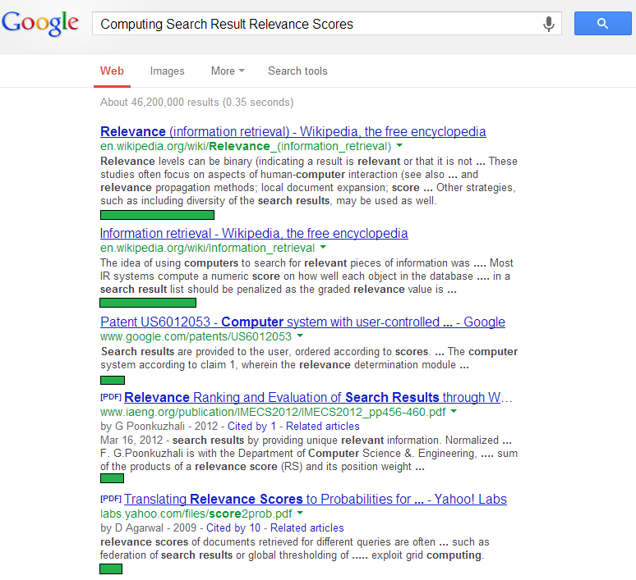
Relevance Displays for Search
Display a relevance score for every search result
Can help users decide how far down to look
Why don’t search engines display them?
Commercial secret?
Simplicity of UI?

Slide 46
User Study: Are Users Influenced by Relevance?
Asking users a set of questions
Who won the 2010 Nobel prize in Economics?
When was Penicillin invented?
Find the phone number of a pizza place in Manhattan.
Name two free music download websites.
…
Users search results through a simple interface.
Relevance scores were added to the result list
Artificial scores
Users did not get an explanation about relevance

Slide 47
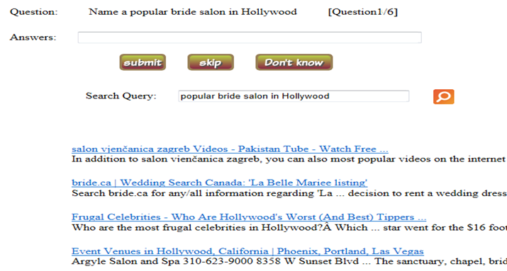
Relevance Displays
No relevance display

Slide 48
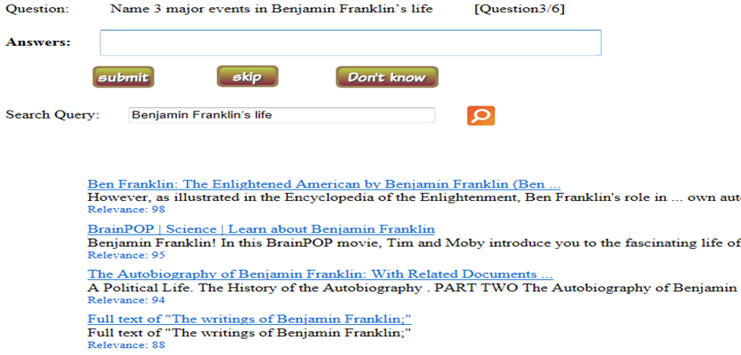
Relevance Displays
Numeric relevance display

Slide 49
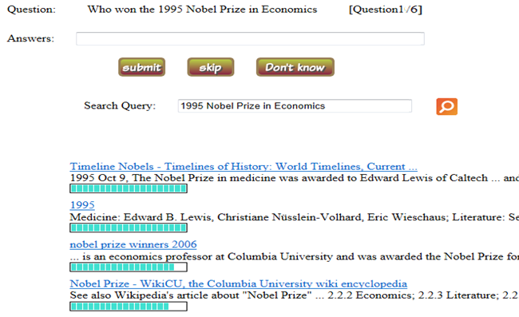
Relevance Displays
Graphical relevance display

Slide 50
Helpfulness in Finding Correct Answers
Do relevance displays help users find correct answers?

Slide 51
Helpfulness in Finding Correct Answers
Do users think that the relevance displays help them?
1 = not at all
5 = very helpful

Slide 52
Do Relevance Displays Affect Users?
Portion of clicks for each position in the results list
Conclusion – people click on more results given relevance displays!

Slide 53
Conclusion
There are many interesting UI related questions
No algorithmic contribution
Can significantly affect user behavior
Much more research is needed!
Difficulty: conducting user studies

Slide 54
Thank you for listening
And hope to see more people doing this type of research!

